Slide 1

Recommendations for Increasing Access to Public Transportation in Chicago
Afsara Ali, Brianna Sanzone, Shengjie Lin, Maitiu Sexton

Slide 2
Problems to Consider
How do we define current demand?
High ridership
Low ridership
Where are employment opportunities concentrated?
Where do people live?
Can we predict and map ridership?
Can we find the most and least popular routes?

Slide 3
Problem Statement
Where would be the most effective place(s) to run additional bus/train service? This will be evaluated based on:
Historical and predicted ridership levels
Locations of employment
Current access to public transit
Population density

Slide 4
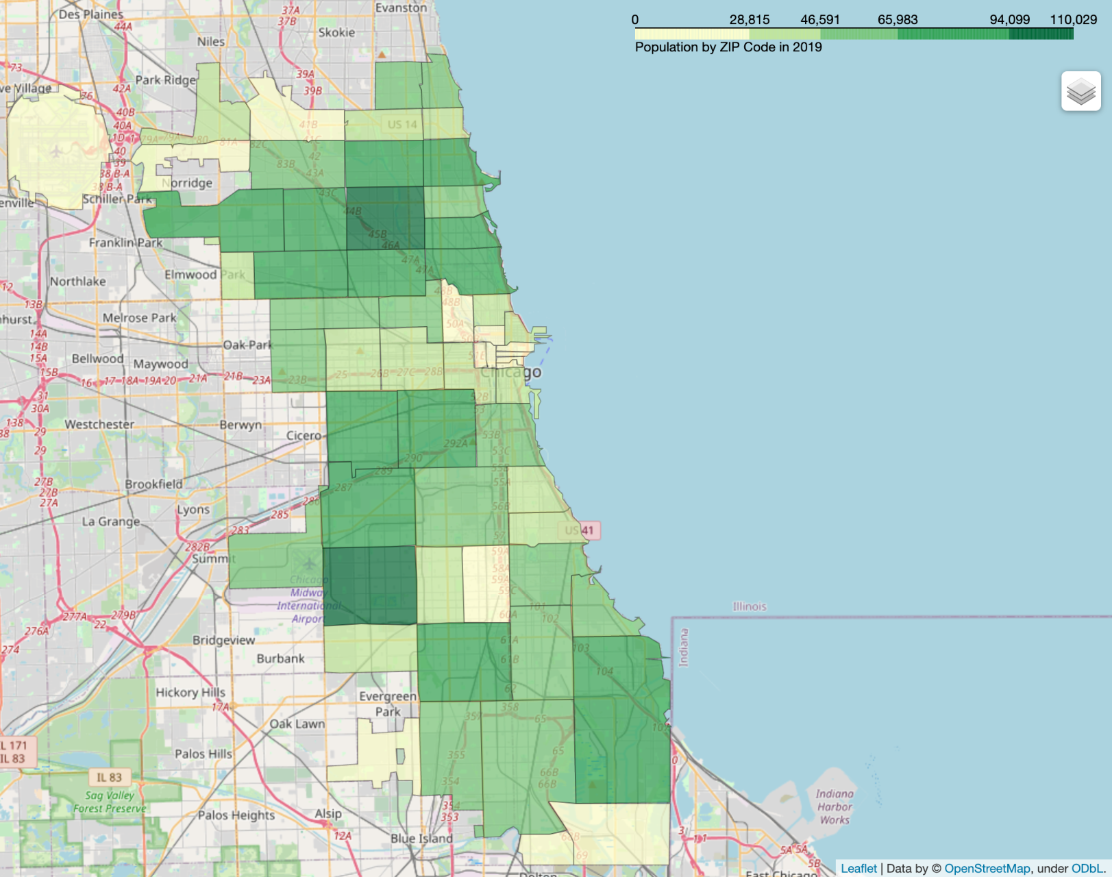
Population by Zip Code (2019)
Percentiles
(darker is higher):
0-25%
25-50%
50-75%
75-98%
98%+

Slide 5
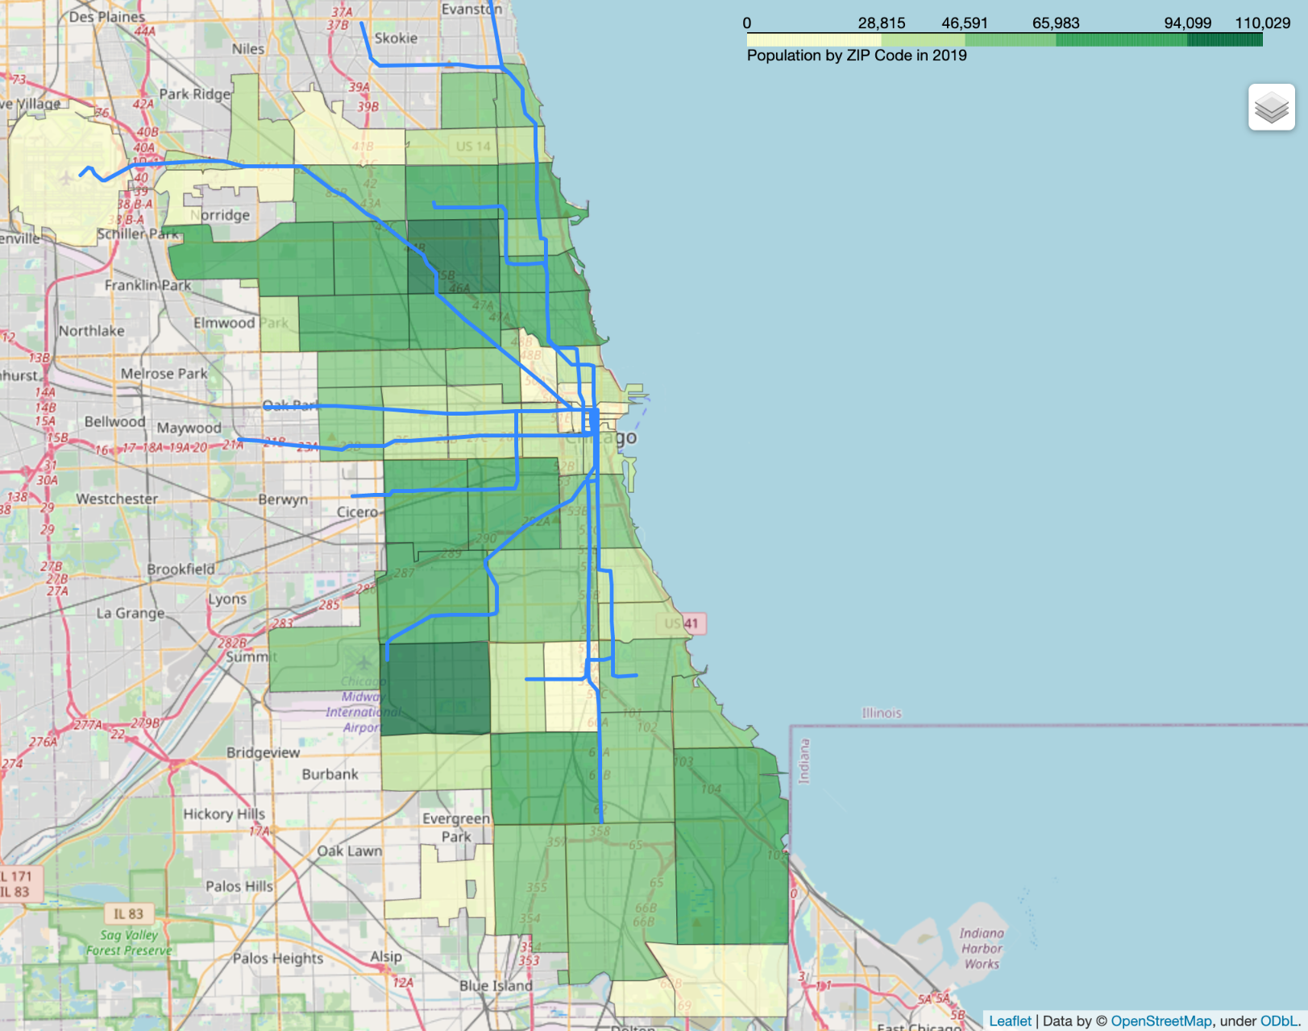
Population by Zip Code (2019)
Percentiles
(darker is higher):
0-25%
25-50%
50-75%
75-98%
98%+
Train Lines

Slide 6
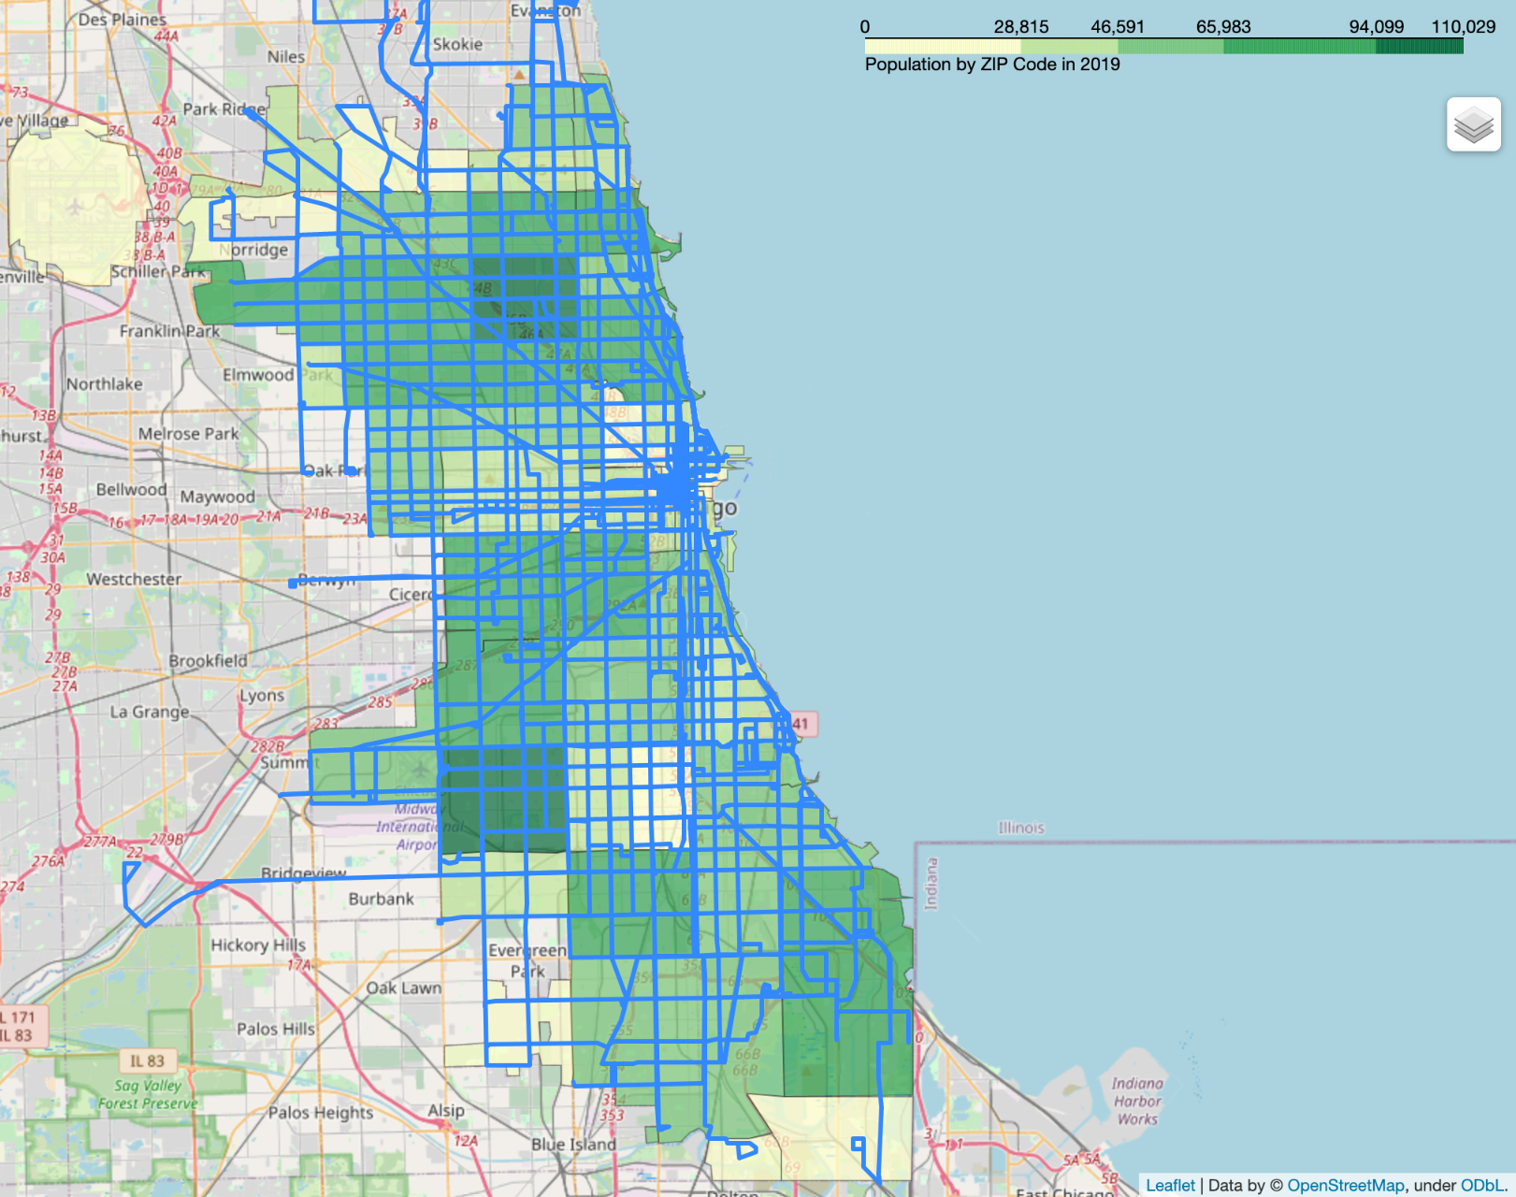
Population by Zip Code (2019)
Percentiles
(darker is higher):
0-25%
25-50%
50-75%
75-98%
98%+
Bus Routes

Slide 7
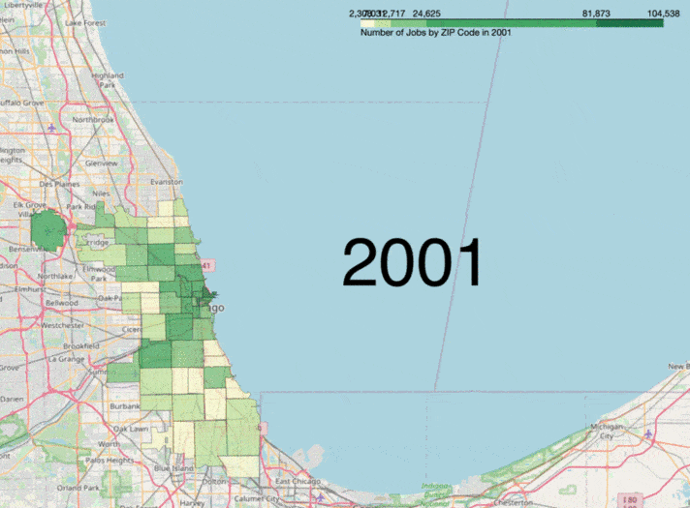
Location of Jobs by ZIP code 2001-2020
Percentiles
(darker is higher):
0-25%
25-50%
50-75%
75-98%
98%+

Slide 8
EDA of Bus and Train Averages

Slide 9
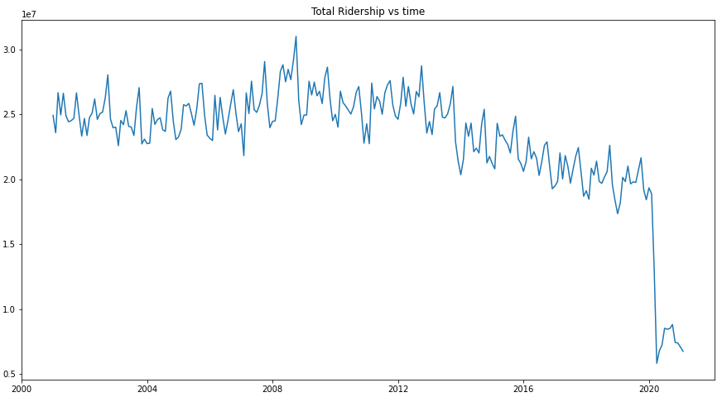
Total Bus Ridership vs Time
Ridership dropped dramatically due to pandemic.
In order to get a better estimate of ridership trend, we dropped the data after 2020.

Slide 10
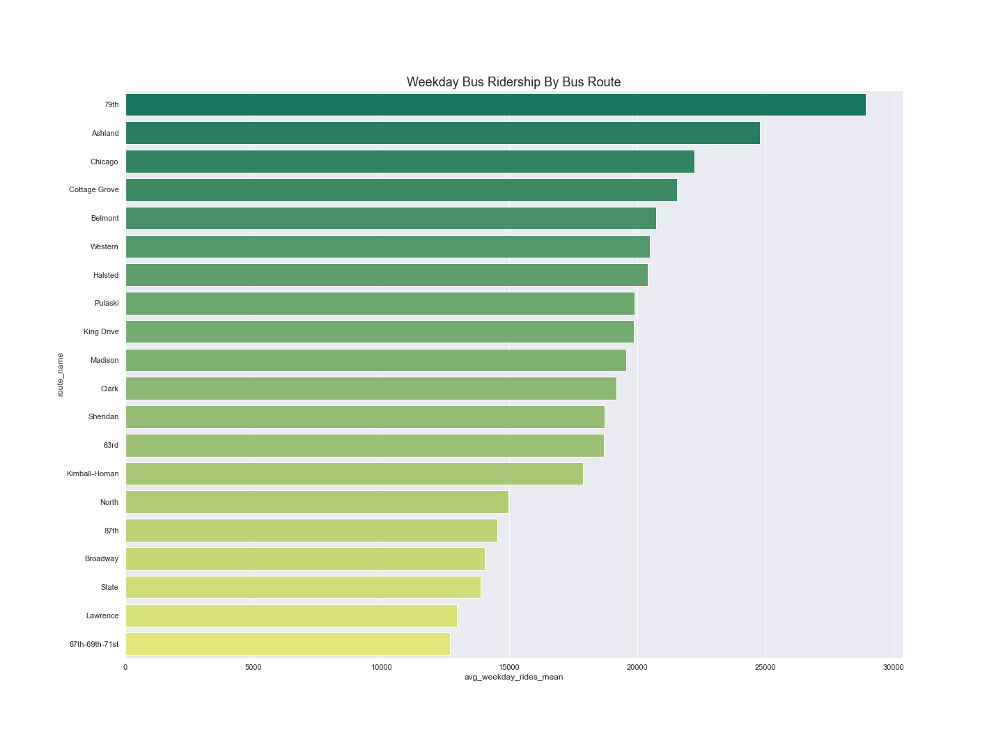

Slide 11
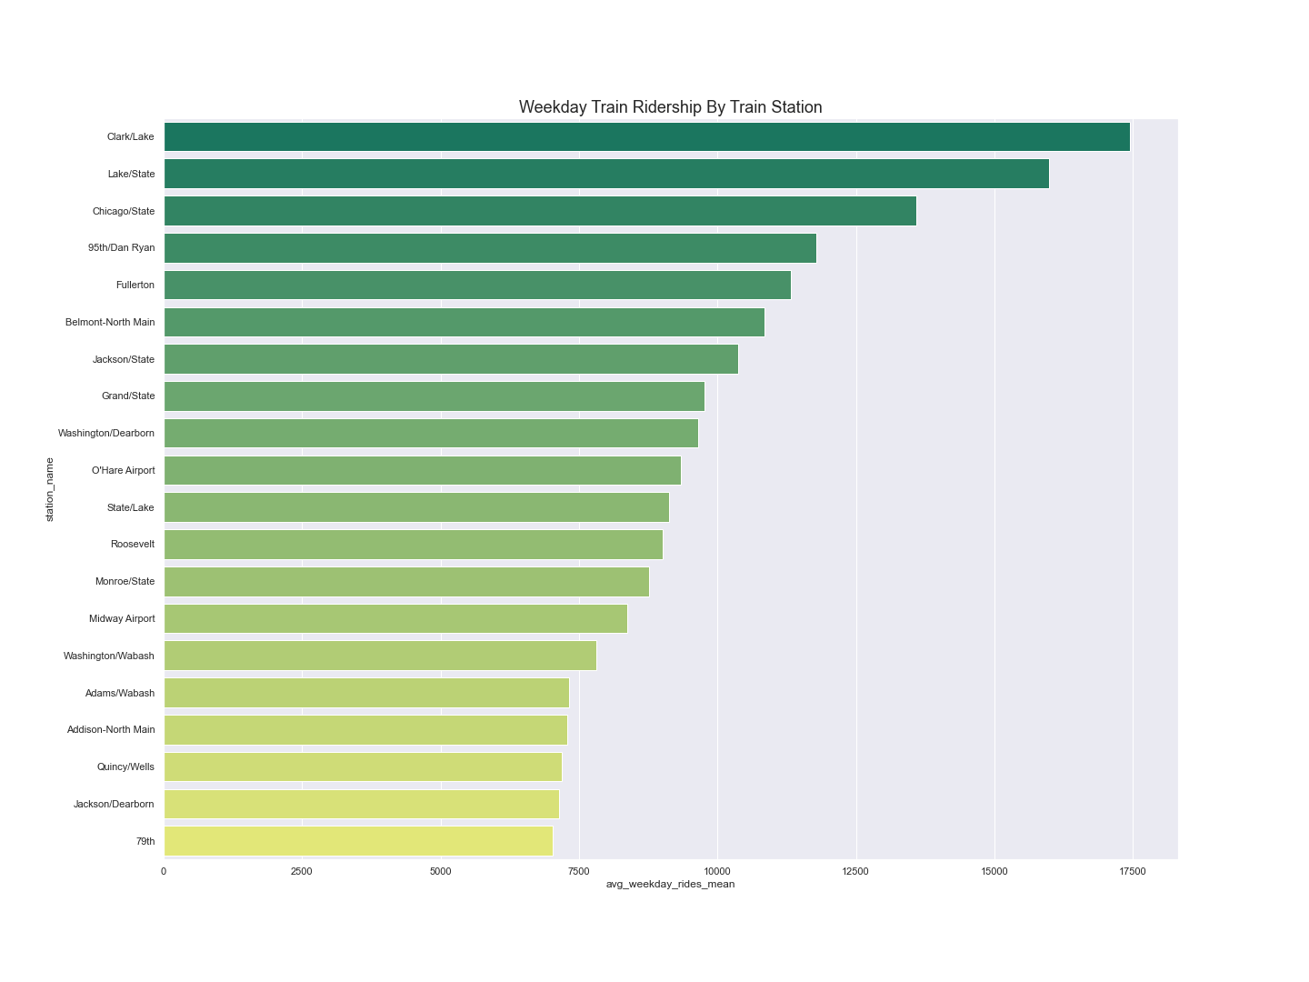

Slide 12
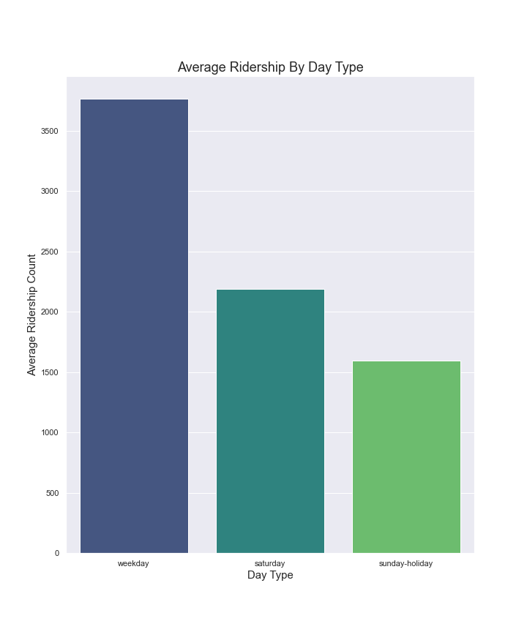
Average Train Ridership by Type of Day

Slide 13
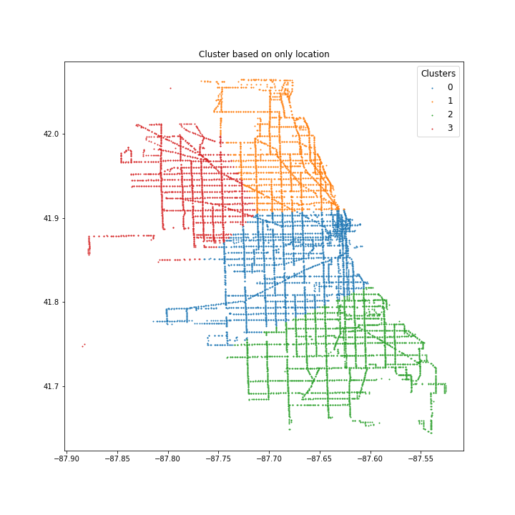
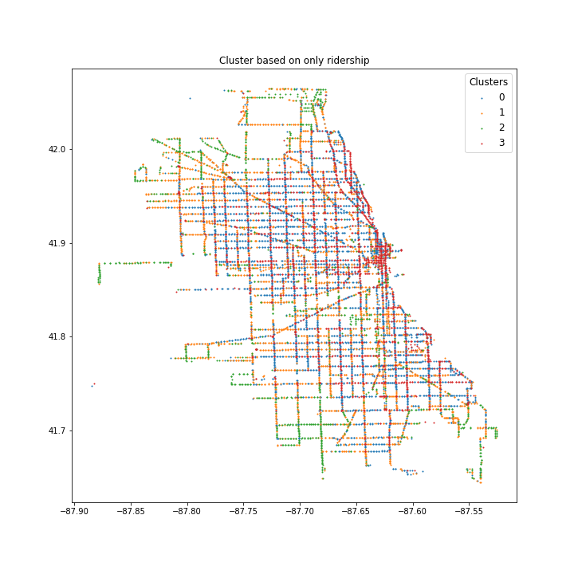
Bus Clustering

Slide 14
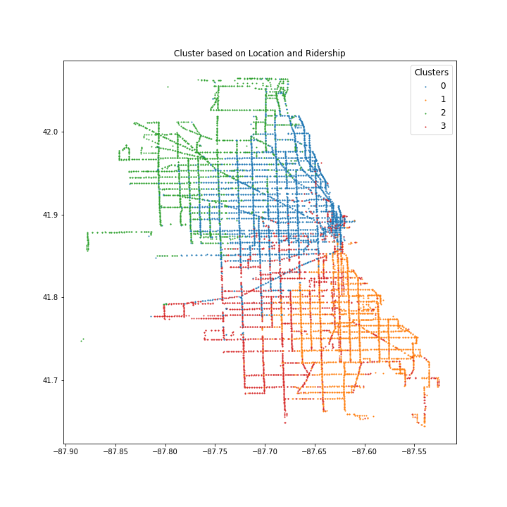
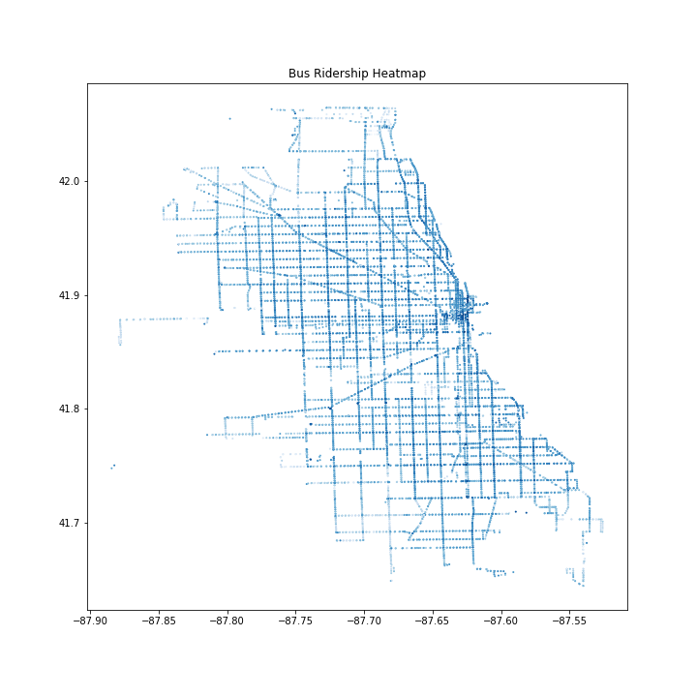
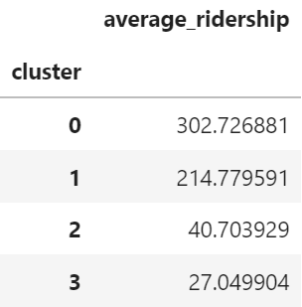
Bus Clustering

Slide 15
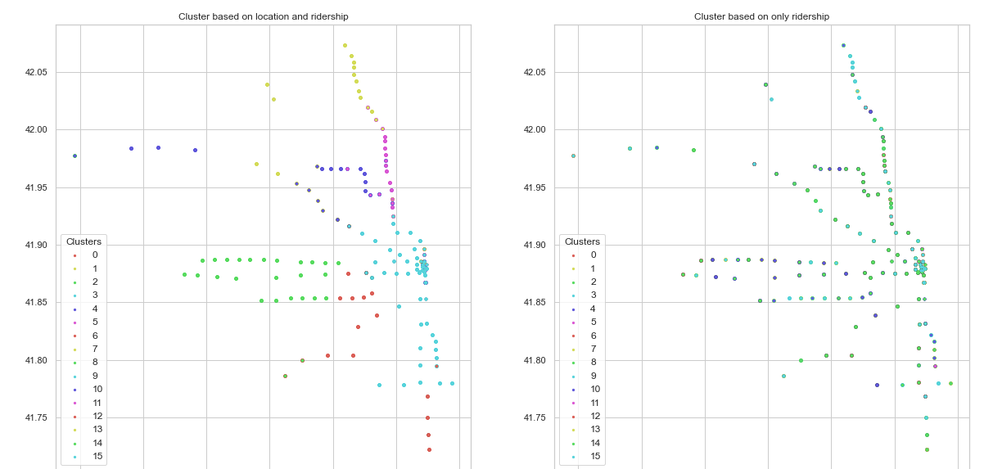
Train Clustering
Best # k clusters: 16
Silhouette Score: 0.42

Slide 16
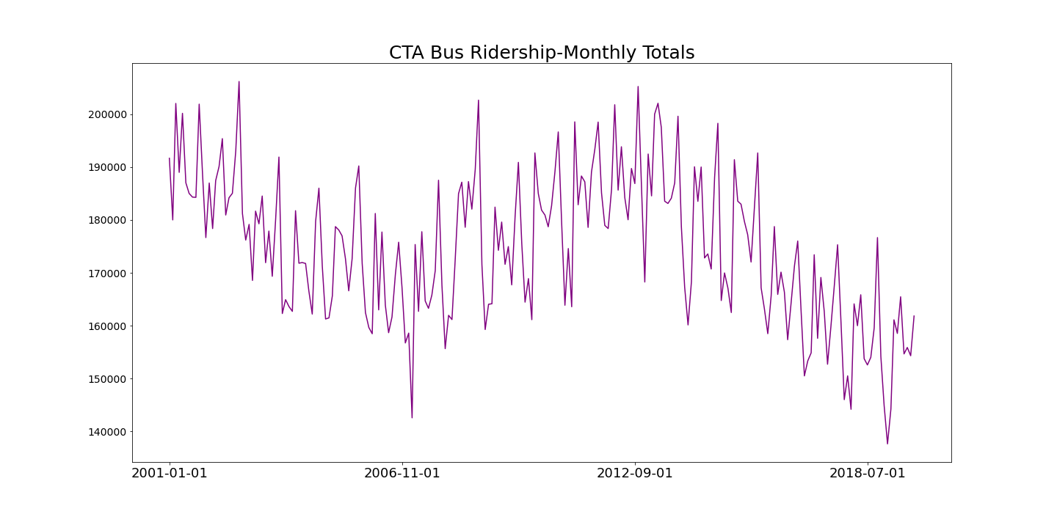

Slide 17
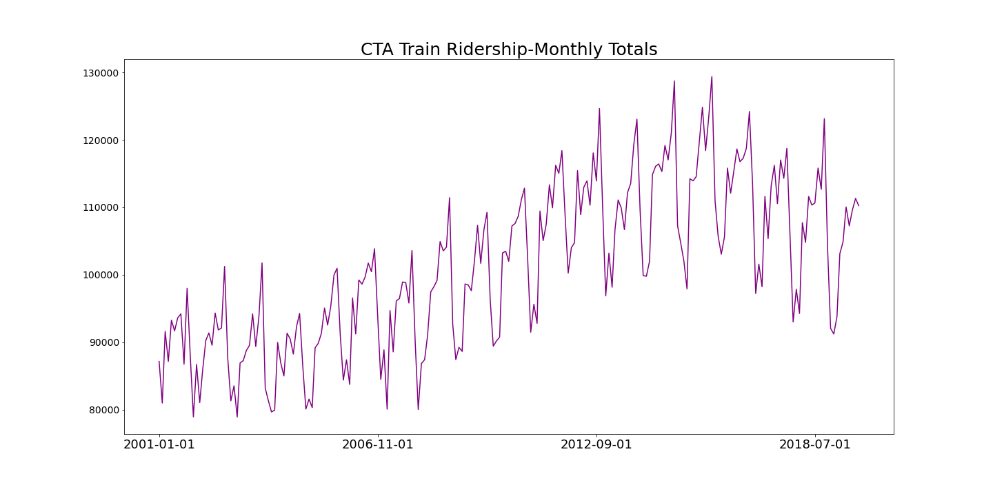

Slide 18
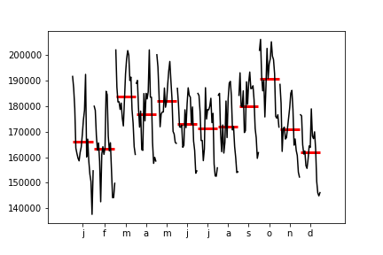
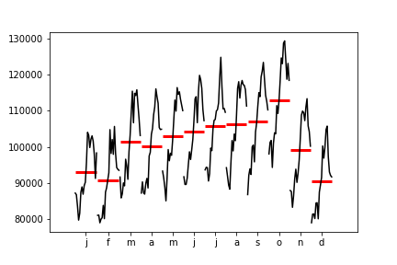
Month Plots
Bus Ridership
Train Ridership

Slide 19
Linear Forecasts

Slide 20
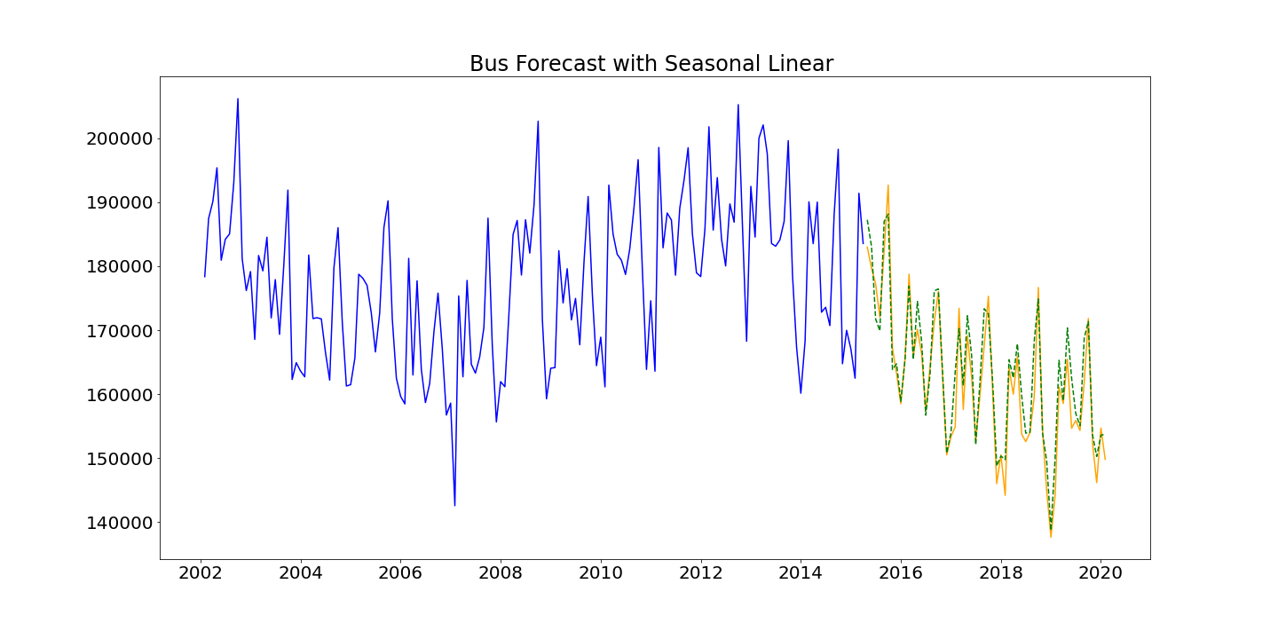
R2 score: 0.89
MSE: 3605.66

Slide 21
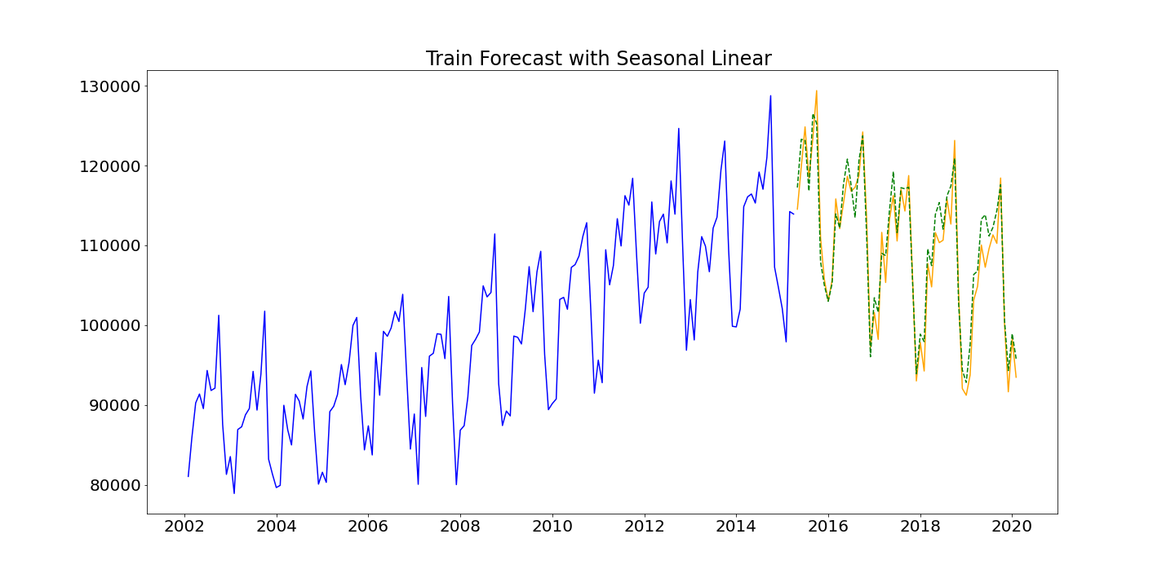
R2 score: 0.93
MSE: 2514.46

Slide 22
Forecasts Using ARIMA

Slide 23
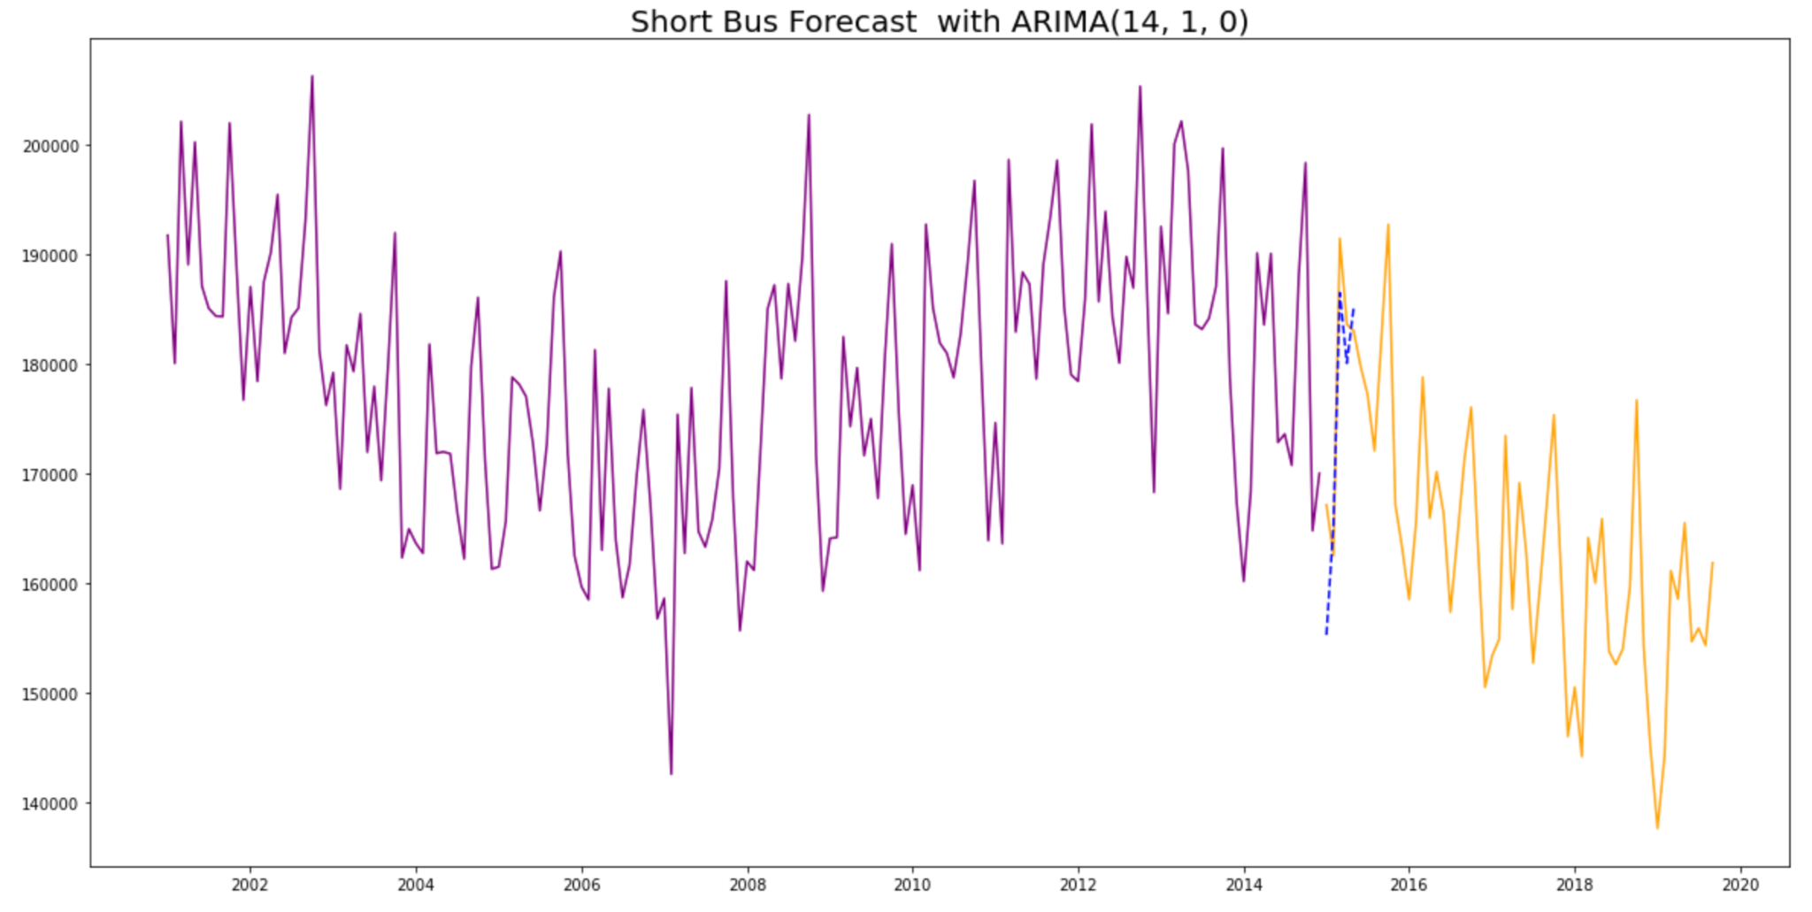
Best params: p = 14, d = 1, q = 0
AIC: 17239.05

Slide 24
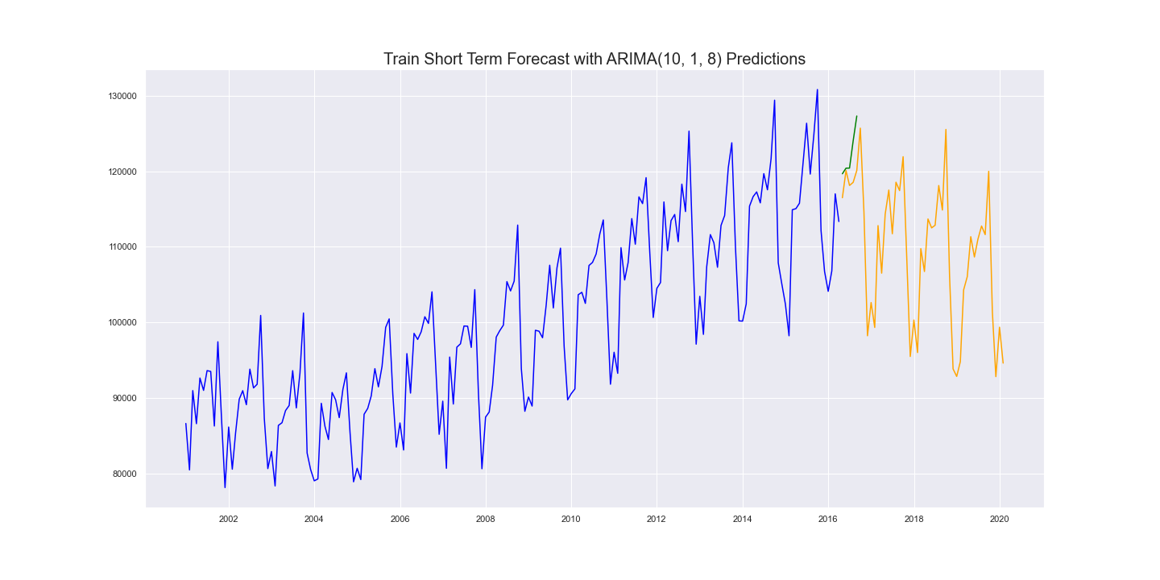
Best params: p = 10, d = 1, q = 8
AIC: 3487.56

Slide 25
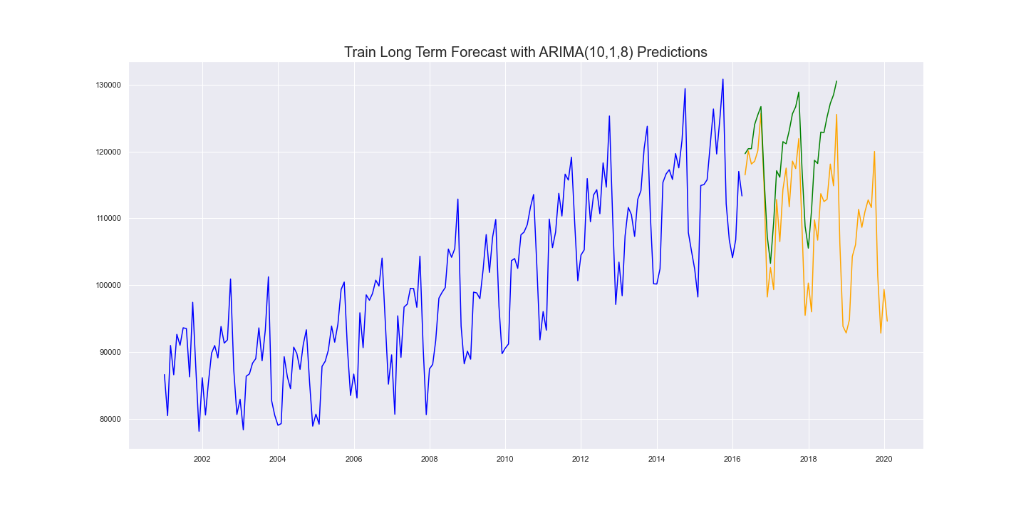
Dataviz goes here
Best params: p = 10, d = 1, q = 8
AIC: 3487.56

Slide 26
Forecasts Using SARIMA

Slide 27
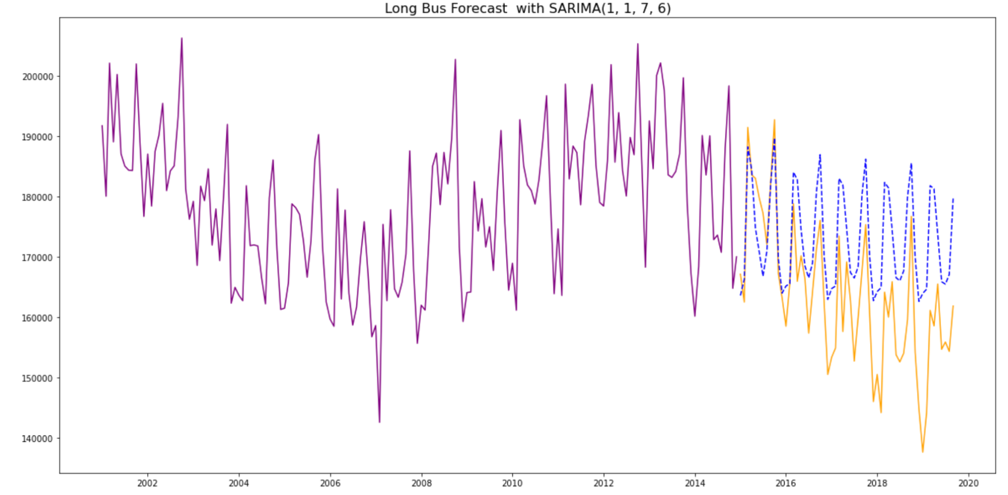
Long term bus
Dataviz goes here
Interpretation goes here
RMSE: 12537.14 AIC: 28

Slide 28
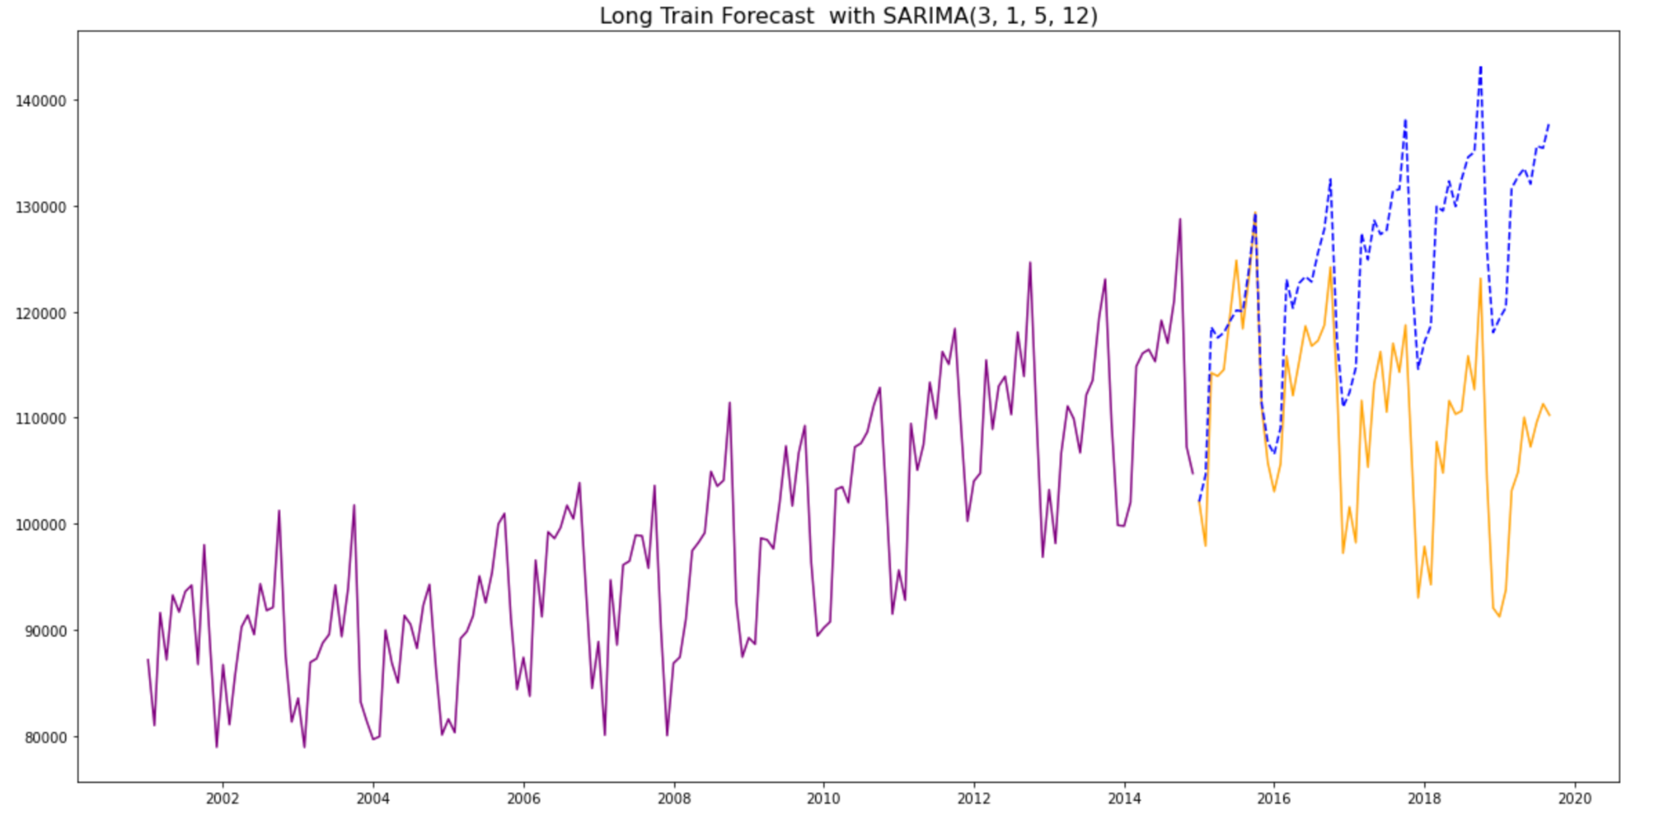
Long term train
Dataviz goes here
Interpretation goes here
RMSE: 16851.8 AIC: 38

Slide 29
Forecasts Using VAR

Slide 30
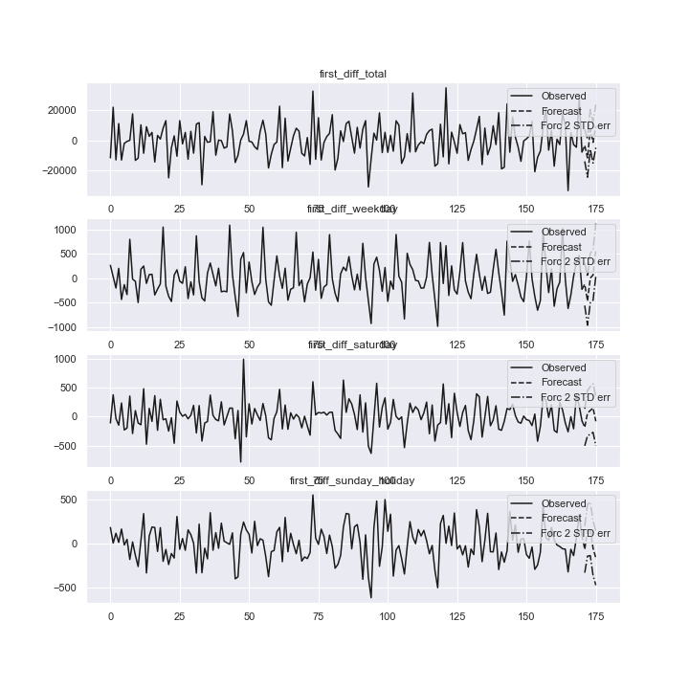
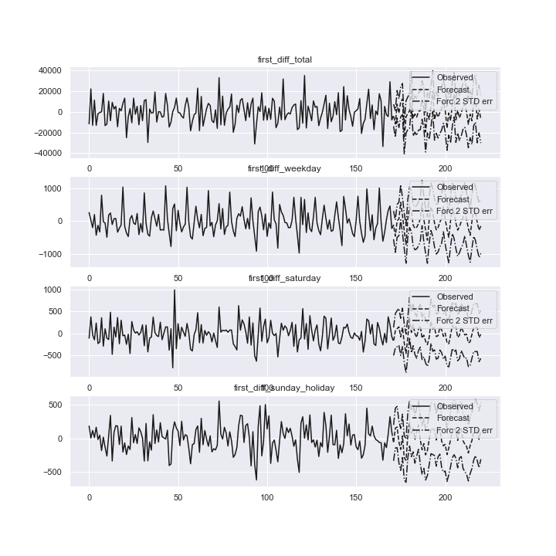
BUS
MSE: 54898731.73
MSE:
56260.02
MSE:
35219.95
MSE: 20590.76

Slide 31
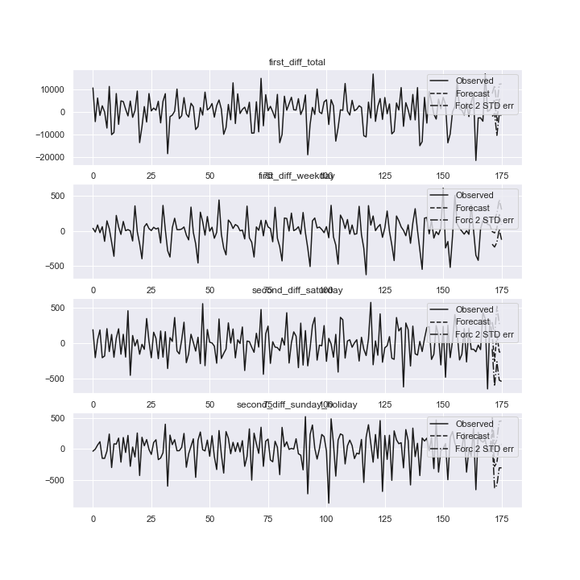
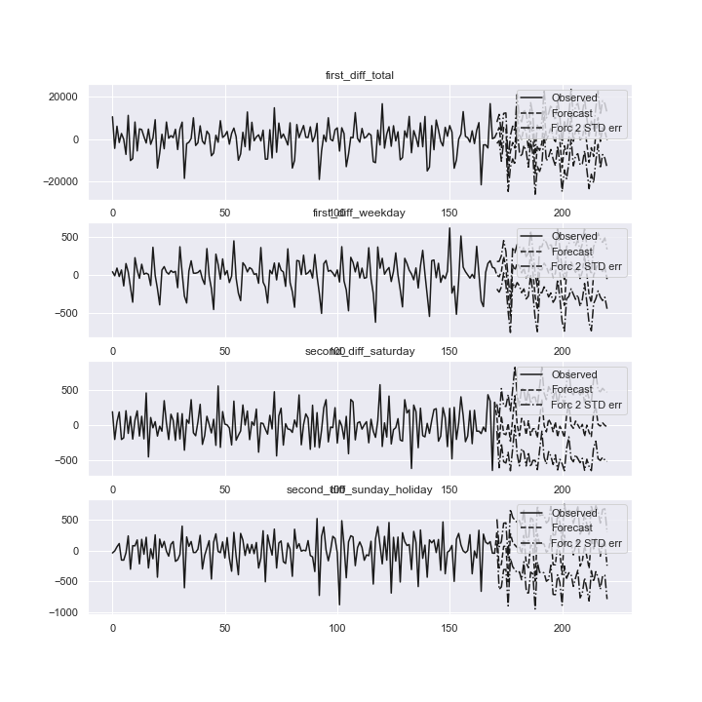
Train
MSE: 39278153.16
MSE:
13559.86
MSE:
57117.2885
MSE: 59747.7861

Slide 32
Trending Routes

Slide 33
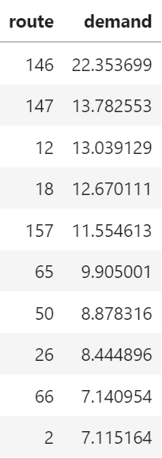
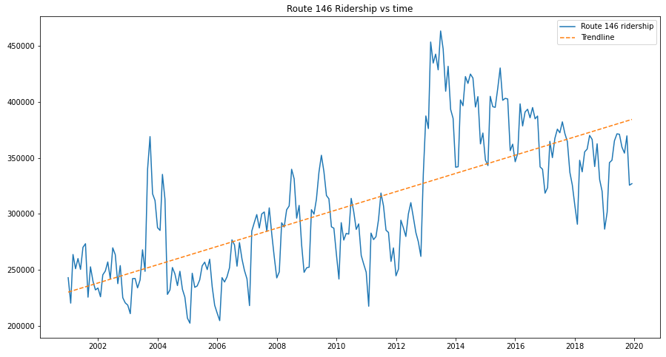
Most Trending Route

Slide 34
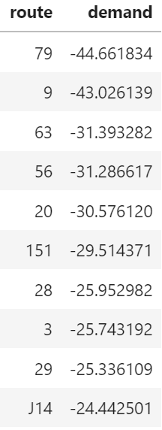
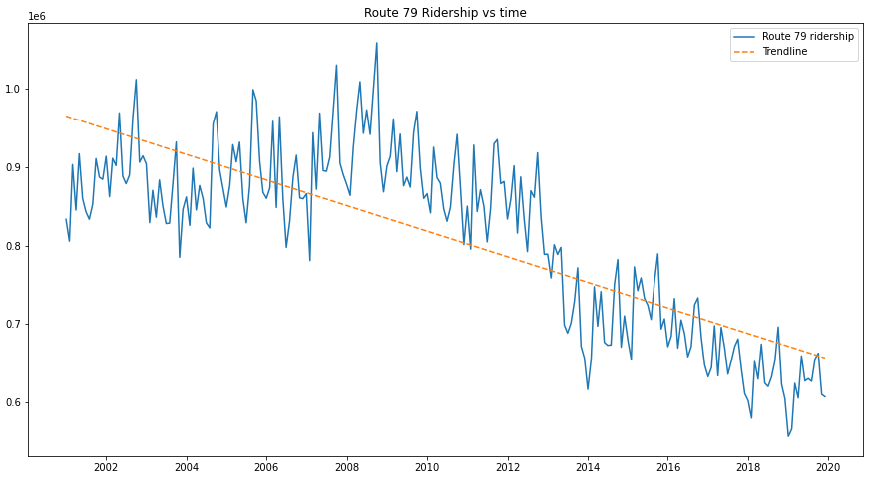
Least Trending Route

Slide 35
Conclusions: Overall ridership is declining. Why?
Alternative transportation availability increasing
Rideshare apps like Uber
Commuter lines suffer during summer and winter
Summer break
Christmas and New Year’s
Discontinued routes/stations
COVID
work from home
Increasing concentration of jobs downtown

Slide 36
Some Recommendations

Slide 37
Ashland BRT (Bus Rapid Transit)
Major North/South route, gap not well serviced
Highest overall ridership (but 2nd fastest loss in ridership)
Cut trip from Fullerton to 79th (15 miles) from 85 minutes to 45 minutes
10% of Chicago lives within ½ mile of this route
1 in 4 of these houses have no car

Slide 38
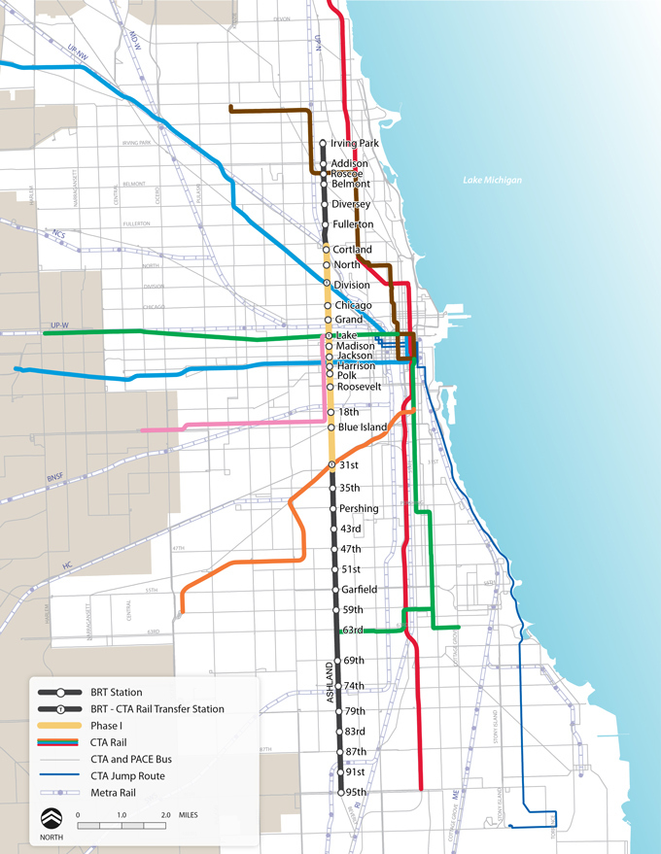
Proposed Stops
source: https://www.transitchicago.com/ashlandbrt/

Slide 39
2. Addition of 83rd St Bus between Cicero & Metra Electric 83rd St. Eastern Stop (Commuter Rail Station)
Fills a mile wide gap through South Side (10 miles long)
83rd St. has higher population density and job density than surrounding areas
Connections to:
Ashburn Metra
83rd St. Avalon Park Metra
Metra Electric 83rd St.
79th St. Red Line
Jeffery Jump downtown express bus

Slide 40
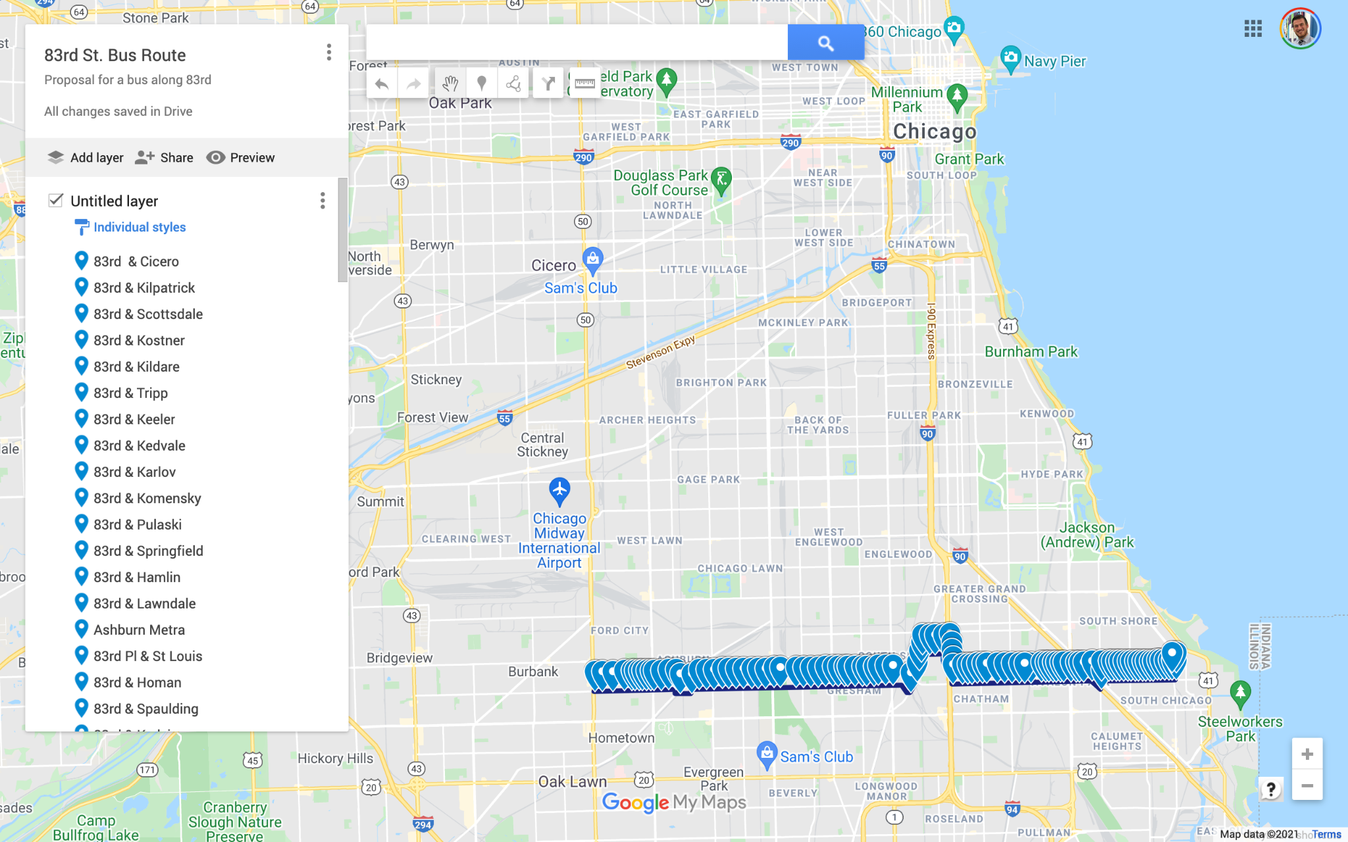

Slide 41
3. Increase service on the following routes:
79th St. Bus #79
63rd St. Bus #63
Green Line Trains to/from Ashland branch (coinciding with Ashland BRT)
151 Sheridan (to balance out increasing demand on 146 Inner Drive Express & 147 Outer Drive Express that run parallel)
J14 Jeffery Jump (hybrid BRT between deep South Side and downtown)
Factors:
Low/decreasing ridership
Higher population density
Current lack of service
Low cost compared to creating new routes

